Slide 1
Traffic Sign Detection in Foggy Weather
Aditya Raj AU1920177
Dhruvanshu Parmar AU1940166
Computer Vision (CSE541)
Guided by:
Prof.Mehul Raval
T.A.Vaishwi Patel
T.A.Arpitkumar Patel

Slide 2
Introduction
In today's world more automobile companies are trying to introduce semi-autonomous feature or fully-autonomous feature to their vehicles. In autonomous vehicle computer vision play a essential role by detecting and recognizing the object for object avoidance. As we know during the challenging condition like fog and rain visibility through camera decreases and it makes harder for the system to detect and recognize. So in this project we are trying to create a model to detect and recognize the object even in the challenging condition.

Slide 3
Problem Statement
In this project we are training the EfficientNetB0 a CNN (convolutional neural network) model which can detect traffic sign even in challenging condition like foggy weather with less inference time and using low computational resources.

Slide 4

Gantt Chart

Slide 5
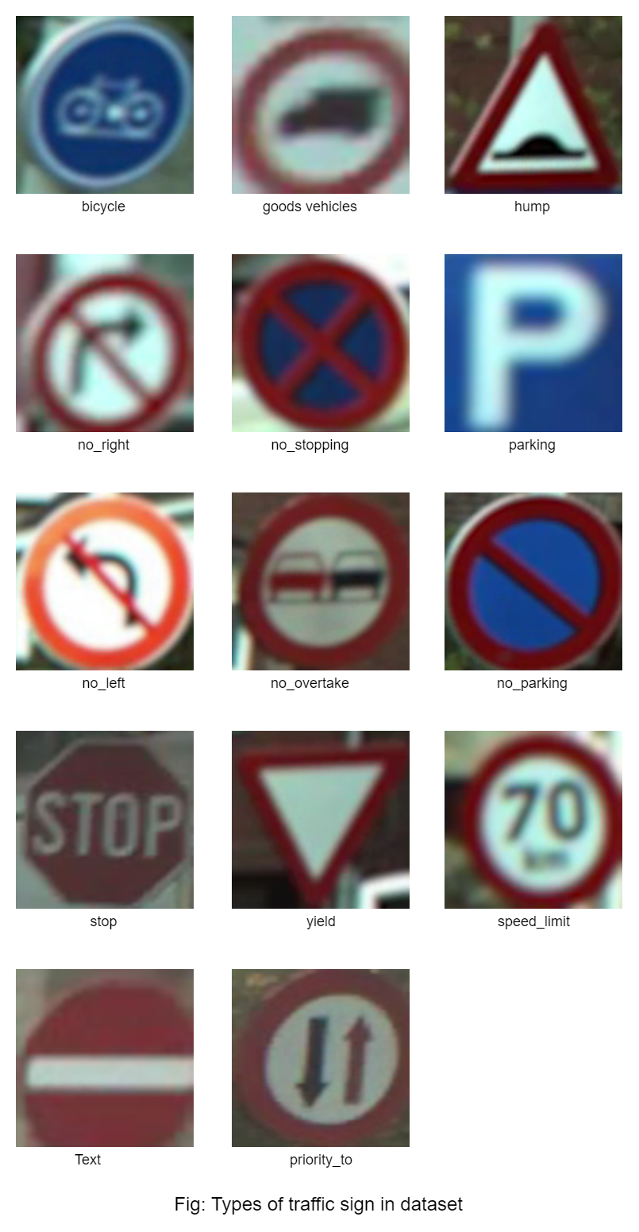
Approach
Part-1: Data
The CURE-TSR[2] (challenging unreal and real environments for traffic sign recognition) dataset is taken from IEEE DataPort platform and the traffic sign images are taken from Belgium traffic sign video sequences.
The dataset has fourteen classes and they are speed limit, goods vehicles, no overtaking, no stopping, no parking, stop, bicycle, hump, no left, no right, priority to, no entry, yield, and parking.

Slide 6
Approach
Total size of the unzipped data is around 10GB.
There are 14 types of traffic signs with different challenging conditions.
From the dataset we only took the Haze and GaussianBlur challenging condition data for our dataset because we are only simulating foggy weather conditions.
Our dataset consist of 72918 training images of 14 class and 33340 images for validation

Slide 7
Approach
Part 2 : EfficientNetB0 model
In this project we used EfficientNetB0 model because this model requires less computational power and low inference time and can be used for mobile devices.
In this model we have used adam optimizer.
We trained the model with two different loss function. first is mean square root (regression loss function) and second is CategoricalCrossentropy (probabilistic loss function)
Using two loss function from different category to understand which category of loss function is performing better.

Slide 8
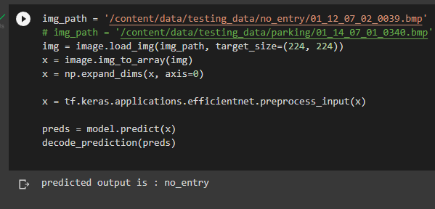

Result
This is the result when mean square error function is used as loss function for the model

Slide 9
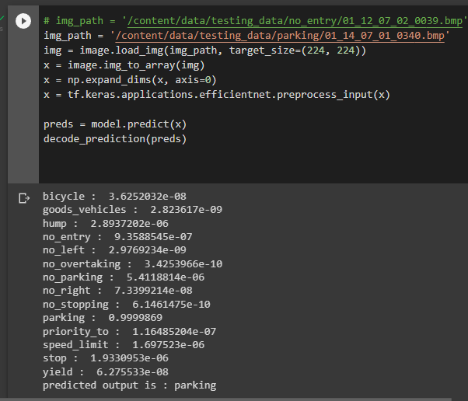

Result

Slide 10
Conclusion
For our project, we used 72918 images of 14 classes to train our EfficientNetB0 models and 33340 images for validation.
There fourteen classes and they are speed limit, goods vehicles, no overtaking, no stopping, no parking, stop, bicycle, hump, no left, no right, priority to, no entry, yield, and parking.
For training we used two loss functions: first is mean square error (regression loss function), and second is CategoricalCrossentropy (probabilistic loss function).
Model is correctly predicting even with very low quality of images.

Slide 11
References
[1] M. Tan and Q. Le, “Efficientnet: Rethinking model scaling for convolutional neural networks,” in International conference on machine learning PMLR, 2019, pp. 6105–6114.
[2] Dogancan Temel, Gukyeong Kwon, Mohit Prabhushankar, Ghassan AlRegib, October 10, 2019, "CURE-TSR: Challenging Unreal and Real Environments for Traffic Sign Recognition", IEEE Dataport, doi: https://dx.doi.org/10.21227/n4xw-cg56.
[3]https://towardsdatascience.com/complete-architectural-details-of-all-efficientnet-models-5fd5b736142

Slide 12
THANK YOU

